Slide 1
Sigma SD Launch
Chris Knudsen
Marketing
February 2018

Slide 2
Agenda
Introduction
Application terms
Spindle vs. Inverter
Features and Benefits
System Overview
Target Machines
Competition
Sales Tools
Support

Slide 3
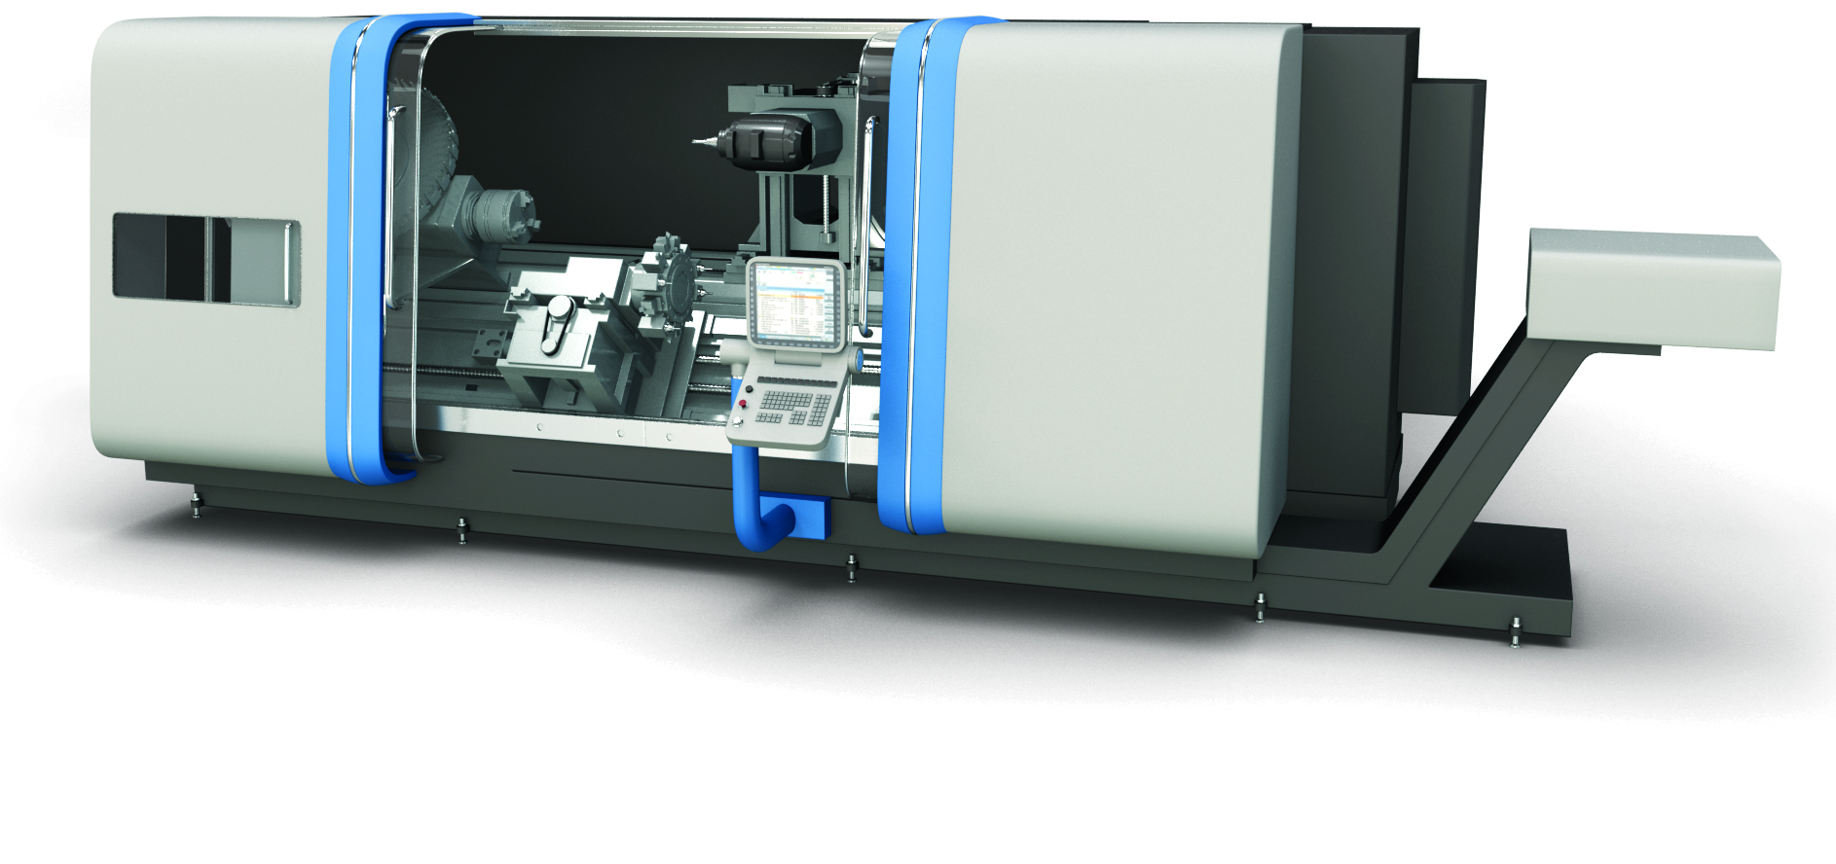
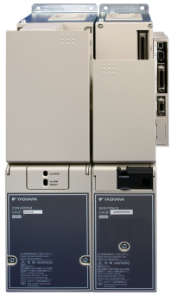
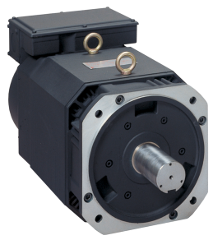
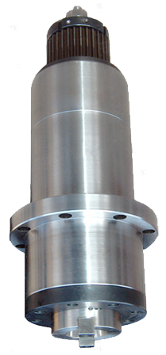
Introduction
Spindle - Rotary axis on a mill driving the tool
Spindle - Rotary axis on a lathe driving the work piece
Machine’s mechanical spindle is usually belt driven by the spindle motor
Sigma SD is specifically designed for this application

Slide 4
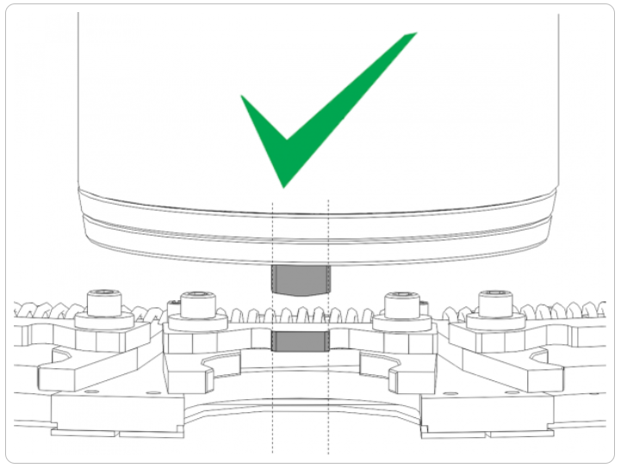
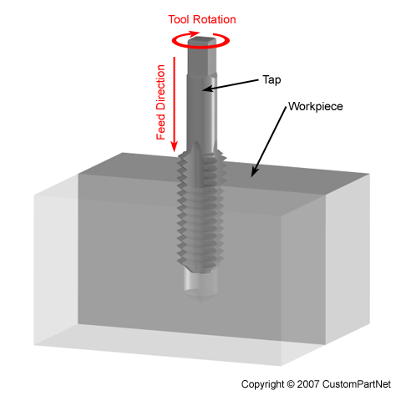
Application Terms
Gain Switching
Changing the position and velocity gains between two settings
By selecting I/O
By commands over EtherCAT
A standard feature that allows for spindle orient and rigid tapping
Spindle Orient
Positioning the mechanical spindle to align with the tool changer
Rigid Tap
Tapping a hole by synchronizing the Z axis position (Feed) with the position and velocity of the spindle
Older method used a flexible tension/compression tap holder

Slide 5
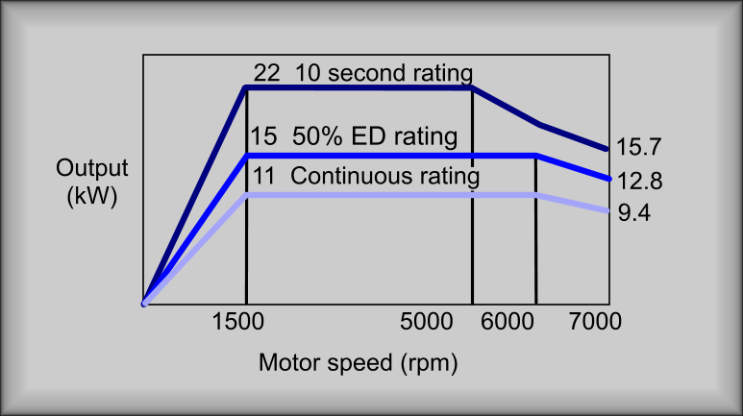
Spindle SD vs. Inverter
Standard inverter duty motor/drive
Base speed: 1750 rpm
Max speed: 3500 rpm
Peak Torque: depends on class
Network update of drive: 1 msec
Velocity control
Sigma SD
Typical base speed: 1500 rpm
Max speed: 7000 rpm. Some models to 10,000 rpm.
Peak torque = 200% continuous torque for 10 seconds
Network update of drive: 250 usec
Drive-motor performance published
Velocity and position control

Slide 6
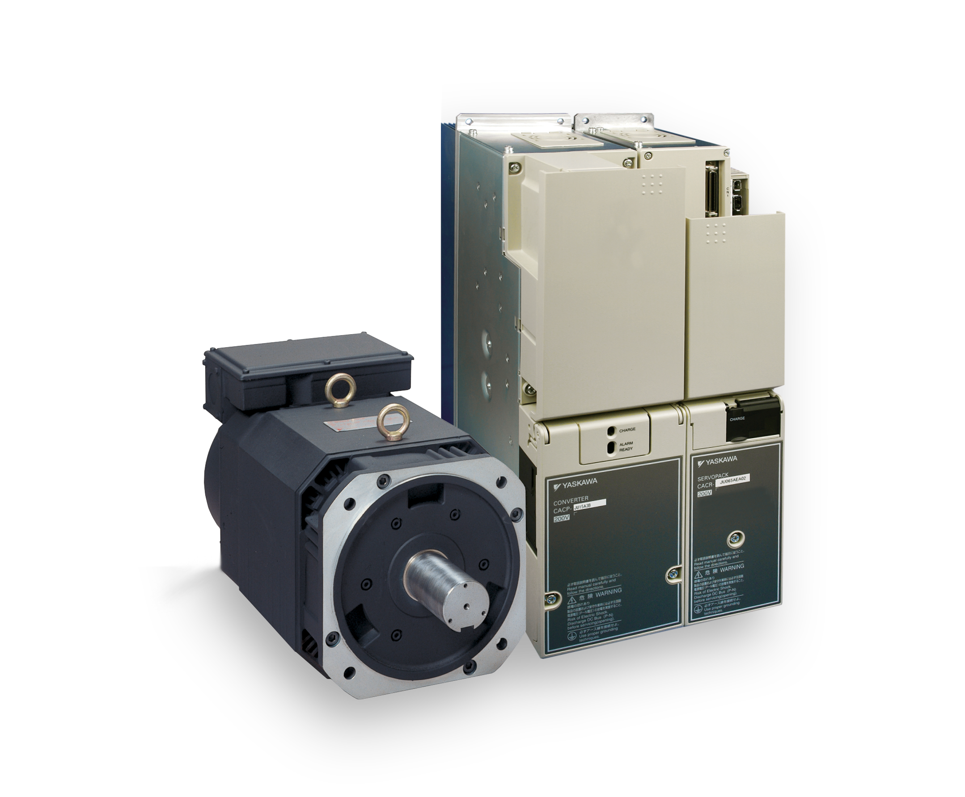
Features and Benefits
Regenerative Converter
Decel energy is regenerated to the line
Saves energy
Reduces heat
High bandwidth drive/motor combination
Low inertia motor
Responds quickly to commands
Produces a smooth finish at high cycle rates
Torque at 0 speed
Built in spindle orient
Well suited for Rigid tapping
Open network protocol
EtherCAT CoE CiA 402 Drive Profile

Slide 7
System Overview
Spindles are rated for 50% duty cycle
5 minutes running, 5 minutes stopped
Continuous rating is one size down
15 kW rated is 11 kW continuous
Drives and motors are sold as combinations only

Slide 8
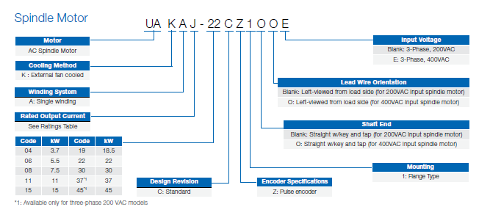
System Overview
Spindle Motor Offering
200 Volts
3.7 to 45 kW Rated
400 Volts
3.7 to 22 kW Rated
Not UL Listed now
CE
Example of 200 VAC, 22 kW rated standard motor
UAKAJ-22CZ1
Example of 400 VAC, 22 kW rated standard motor
UAKAJ-22CZ1OOE

Slide 9
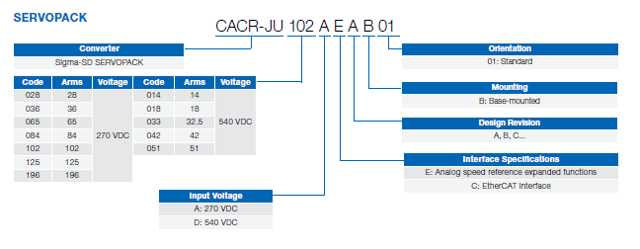
System Overview
Spindle Drive Offering
200 Volts
3.7 to 45 kW Rated
Analog or EtherCAT
400 Volts
3.7 to 22 kW Rated
Analog or EtherCAT
UL Recognized
CE
Example of 200 VAC, 22 kW rated, Analog Drive
CACR-JU102AEAB
Example of 400 VAC, 22 kW rated EtherCAT motor
CACR-JU051ACAB

Slide 10
System Overview
Converter Offering
200 Volts
15 to 45 kW Rated
400 Volts
15 to 22 kW Rated
UL Recognized
CE
Example of 200 VAC, 22 kW rated, Converter
CACP-JU22A3BB
Example of 400 VAC, 22 kW rated, Converter
CACR-JU22D3BB

Slide 11
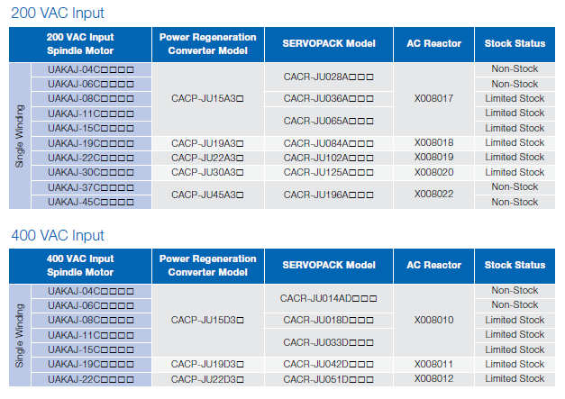
System Overview
Limited Stock Launch
1 to 2 units per part number
Retrofits and prototypes
OEM business needs to be forecasted

Slide 12
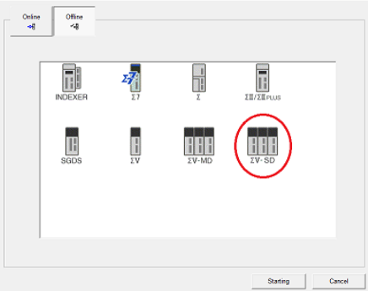
System Overview
Cables, Reactor, Line Filters
Reference the Sigma SD Technical Supplement
Motor has terminals, no power cable
Online Price Tool for Bill Of Materials
Commissioning
SigmaWin+ Ver. 5.75
Hand held digital operator

Slide 13
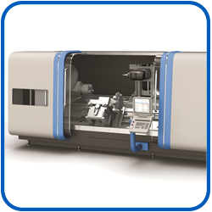
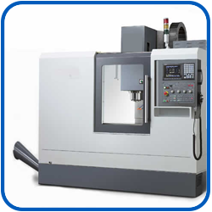
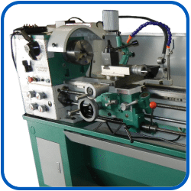
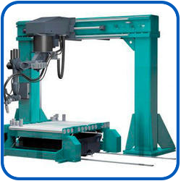
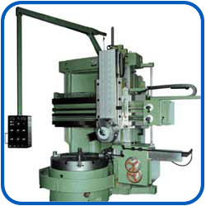
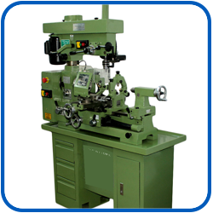
Target Machines
Targets
Lathes
Mills
Turning centers
Machining centers
Boring mills
Coping machines
Drilling machines
Not Targets (speeds too high)
Router
Grinder

Slide 14
Competition
Retrofits
Inverters are commonly used to interface to an existing motor
Inverters sacrifice speed, speed regulation, and bandwidth
Often requires extra engineering to accomplish spindle orient
Often performance at low speed is too course for rigid tapping
New Installations
Fanuc, Siemens, and Mitsubishi sell spindles as part of closed architecture systems
Yaskawa has analog and EtherCAT for open systems
Third party CNC’s
Centroid
MachMotion
Power Automation
In House controls

Slide 15
Sales Tools
Launch PowerPoint
Brochure
Technical Supplement
www.yaskawa.com
Online Price Tool

Slide 16
Support
800-YASKAWA
RME’s for pre-sales support
Aftermarket service will quote time and material:
Installation
Commissioning
Retrofit of legacy Yaskawa spindles
MT2
MT3
VM3
M5
Contact the factory for special quotes (for repeat business)
Modified torque-speed curves
Dual Winding Motors

Slide 17
Questions
Q) Can the Sigma SD run a legacy Yaskawa spindle motor?
A) In many cases yes if it was from the MT2, MT3, VM3, or M5 series. Check with service for a time and material retrofit quotation.
Q) Can the SD run another manufacturer’s spindle motor?
A) Like our servos, Yaskawa tests all combinations of spindle drives and motors as part of our quality policy allowing fast installation and start up and reference to a published performance curve. Running a third party spindle motor would require testing which would make it uneconomical unless volume is high.
Q) Can the A1000 be used in a spindle application?
A1000’s have been used in spindle applications. Contact your Yaskawa Drives sales representative for more details.

Slide 18
Questions
Q) What is Yaskawa’s repair policy for Sigma SD.
A) Yaskawa will maintain one unit in stock for repair-exchange if a unit goes down. Critical installations should have a spare.
Q) What is the lead time if a unit is not in stock?
A) Yaskawa will stock to an OEM’s forecast on top of the limited stock planned for the launch. Limited stock units are re-ordered after a sale and will be in process. The worst case lead time is 16 weeks.
Q) What is the factory warranty?
A) The normal 18 month warranty in our standard terms and conditions applies. Extended warranties can be purchased.

